Slide 1

Kalman Filter
and
Extended Kalman Filter(EKF)
By
Weitao Xiong
Advisor:
Prof. Hongfei Xue

Slide 2
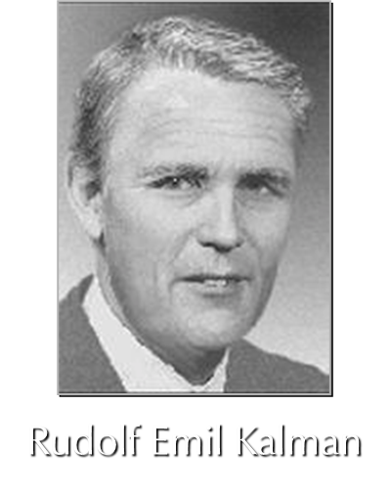
Kalman Filter
Seminal paper by R.E.Kalman, 1960
Set of mathematical equations
Optimal estimator
minimum mean square error
Versatile
Estimation
Filtering
Prediction
Fusion

Slide 3

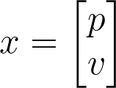

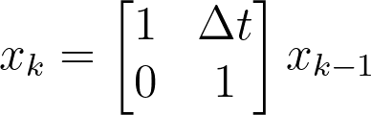
Kalman Filter: Start with an simple example
We start a car in position X_(k-1) and drive it at a constant speed. We want to track where our car is at time k. It seems very simple because we know the formula is
Convert them to a matrix
However, it is not perfect. In the real world, there exists many noise and uncertainty. So we can’t just use an input that you get from the sensor to put it in a formula to get an actual result.

Slide 4
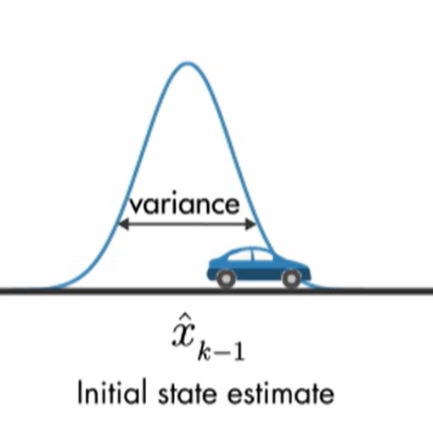
Internal Noise and uncertainty
We can just assume that the velocity and position we get from the sensor are Gaussian distributed. Because when only the mean and variance are known, the Gaussian distribution is the most reasonable choice for modeling uncertainty because it makes the least assumptions about unknown factors.
For at the initial state k-1, the car position can be any number in the distribution. So we can see it is an estimated value.
Estimated
Stated

Slide 5
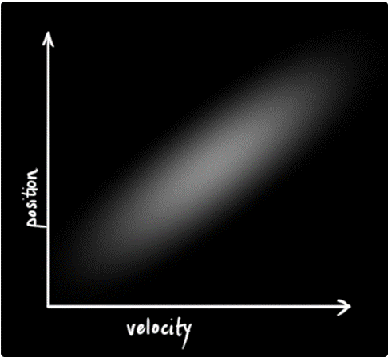
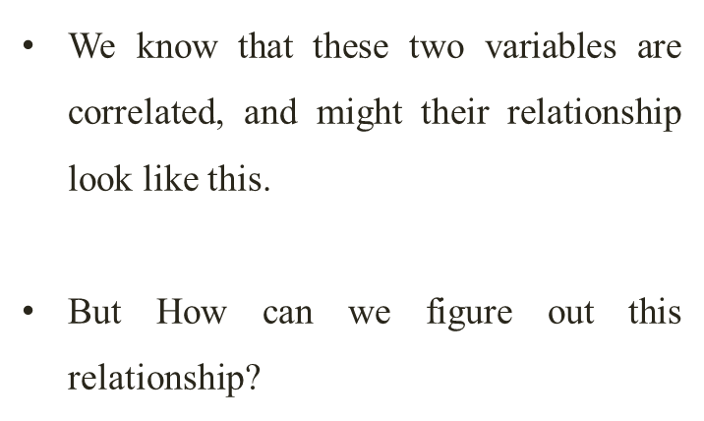

Slide 6
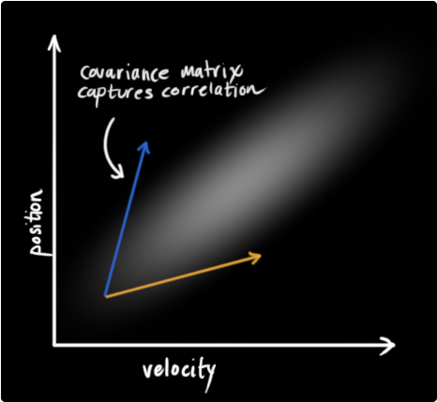

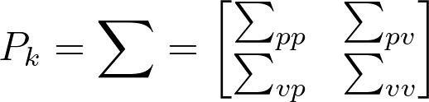


We can capture it by using the covariance. It represents your uncertainty about the state of the system
Covariance matrices P_k are often labeled “Σ”, so we can write
: Covariance matrices
: Position at k time
Next page we will talk about the four element in the matrix

Slide 7



The first diagonal element represents the uncertainty of the position
The second diagonal element represents the uncertainty of the velocity
The rest of the two represents the correlation between noise in measurements to the speed and to the position of the car

Slide 8
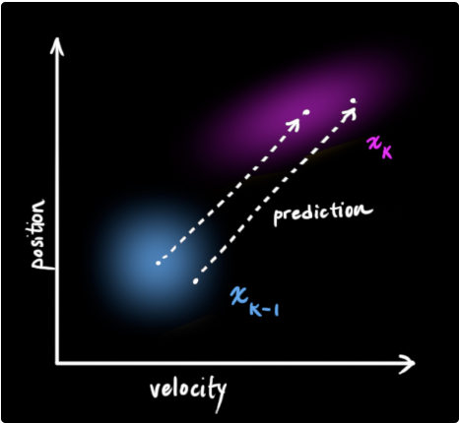
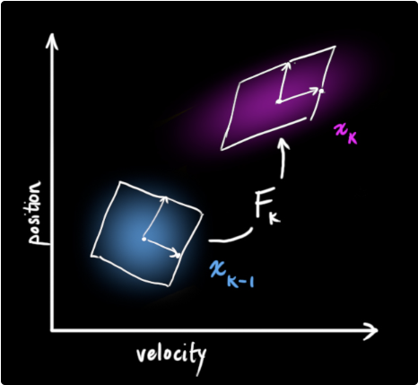
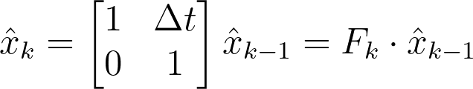
We can represent this prediction step with a matrix, F_k

Slide 9



We know the formula below
Then we can update our covariance matrix
However, it is not done yet, because there also exists External influence and External uncertainty

Slide 10

External Influence
External Influence is the thing in the outside world that could be affecting or controlling the system.
For example, if the state models the motion of a train, the train operator might push on the throttle, causing the train to accelerate.
Similarly, in our robot example, the navigation software might issue a command to turn the wheels or stop. If we know this additional information about what’s going on in the world, we could stuff it into a vector called u_k, do something with it, and add it to our prediction as a correction.

Slide 11
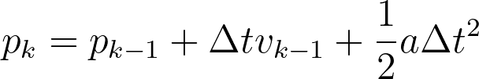

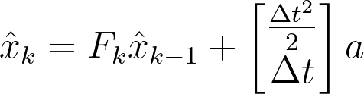


If we know the expected acceleration “a” due to the throttle setting or control commands. Then we can update our formula
In matrix form:
: is called the control matrix

Slide 12
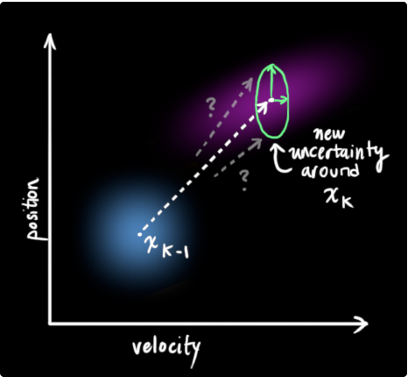
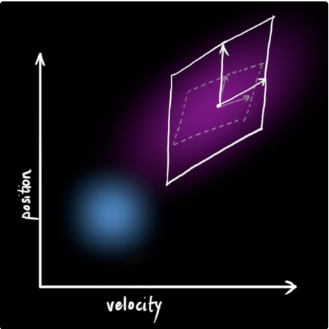
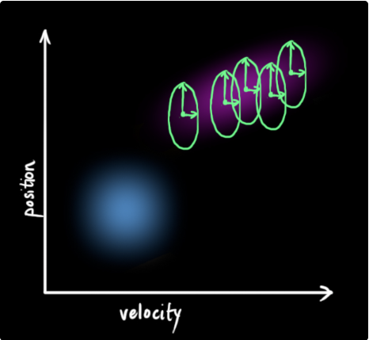

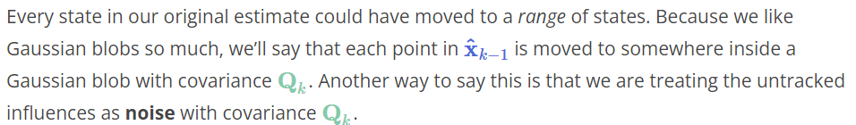
External Uncertainty
External Uncertainty is something we can’t track outside.
For example, if we’re tracking a quadcopter, it could be buffeted around by wind. If we’re tracking a wheeled robot, the wheels could slip, or bumps on the ground could slow it down.
This produces a new Gaussian blob, with a different covariance (but the same mean)

Slide 13


In other words, the new best estimate is a prediction made from the previous best estimate, plus a correction for known external influences.
And the new uncertainty is predicted from the old uncertainty, with some additional uncertainty from the environment.

Slide 14
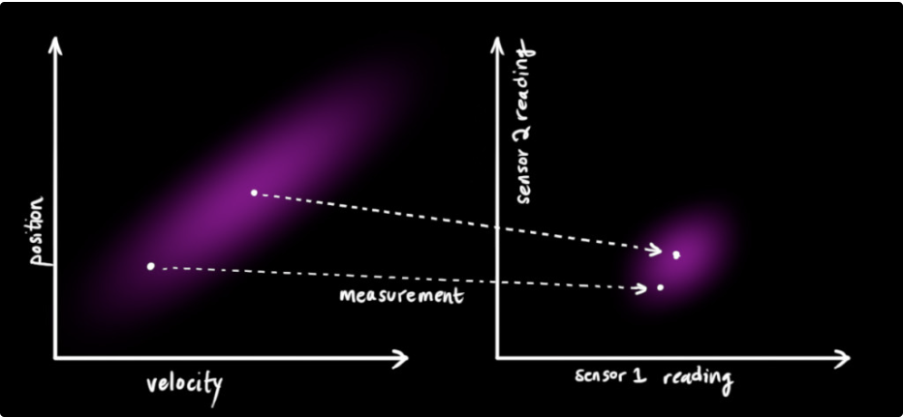
Refining the estimate with measurements
Each sensor tells us something indirect about the state— in other words, the sensors operate on a state and produce a set of readings.

Slide 15
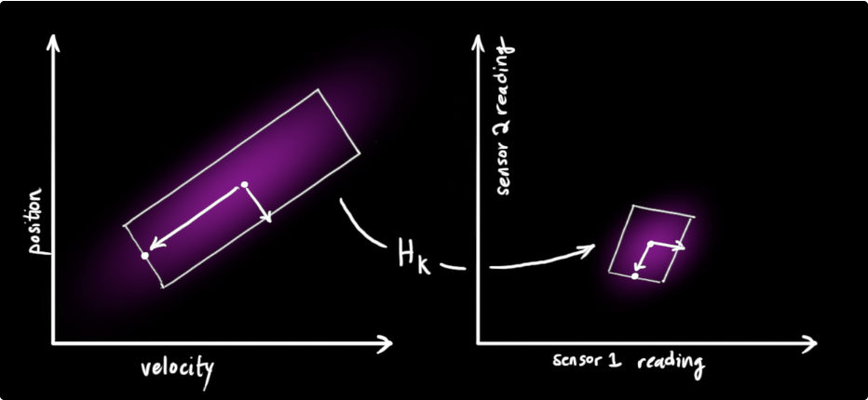


Notice that the units and scale of the reading might not be the same as the units and scale of the state we’re keeping track of.
So we’ll model the sensors with a matrix, H_k.

Slide 16
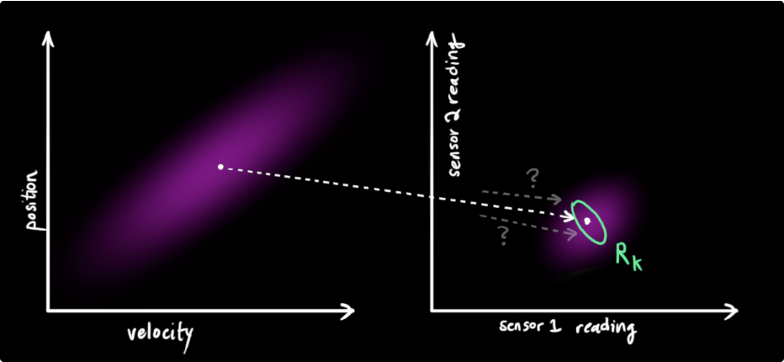
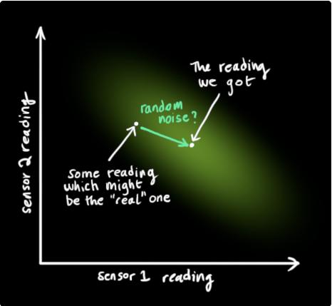


The observed Measurement from sensor
From each reading we observe, we might guess that our system was in a particular state. But because there is uncertainty, some states are more likely than others to have produced the reading we saw.
We’ll call the covariance of this uncertainty (i.e. of the sensor noise) R_k.
The distribution has a mean equal to the reading we observed, which we’ll call z_k.

Slide 17
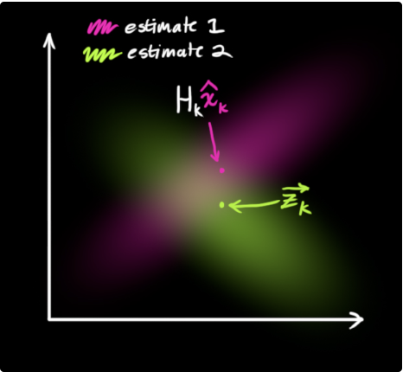
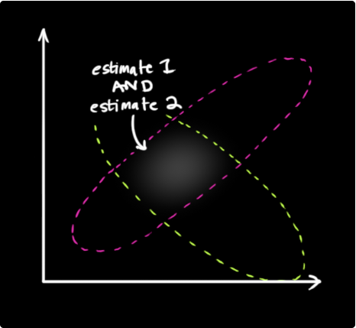
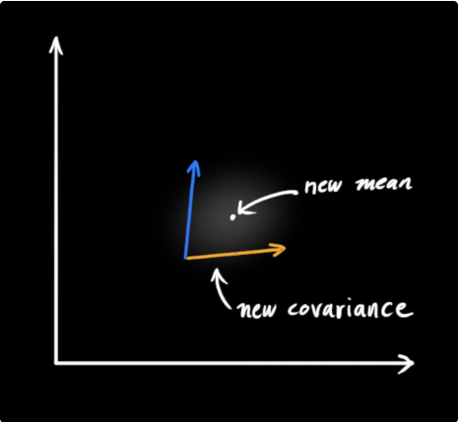
We must try to reconcile our guess about the readings we’d see based on the predicted state (pink) with a different guess based on our sensor readings (green) that we actually observed.
If we have two probabilities and we want to know the chance that both are true, we just multiply them together. So, we take the two Gaussian blobs and multiply them.

Slide 18
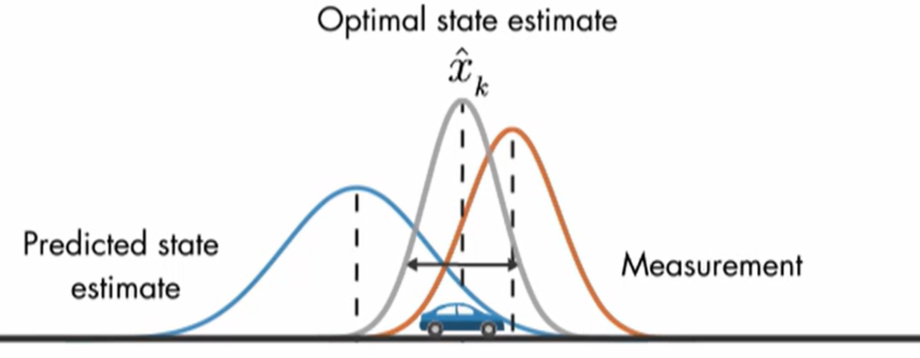
We can get a new Optimal state estimate by combining two of them.

Slide 19
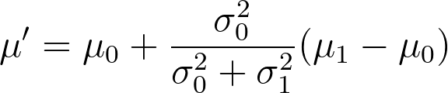
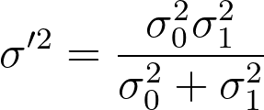
Combining Gaussians
After we multiply two of the distributions, We can get a new one
For more detail about how to deduct the formula, you can see the paper Kalman Filter: Multiplying Normal Distributions
μ₀
μ₁
https://www.Norbert-freier.de/dateien/kalman_filter_multiplying_normal_distributions_norbert_freier_2013.pdf

Slide 20
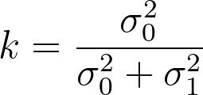





We can simplify as below：
Convert in matrix version:
K is a matrix called the Kalman gain

Slide 21

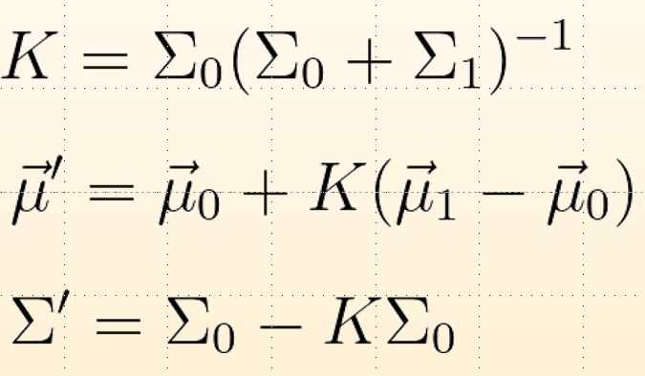
Predicted Measurement:
Observed Measurement:
Then we can convert these
as below

Slide 22

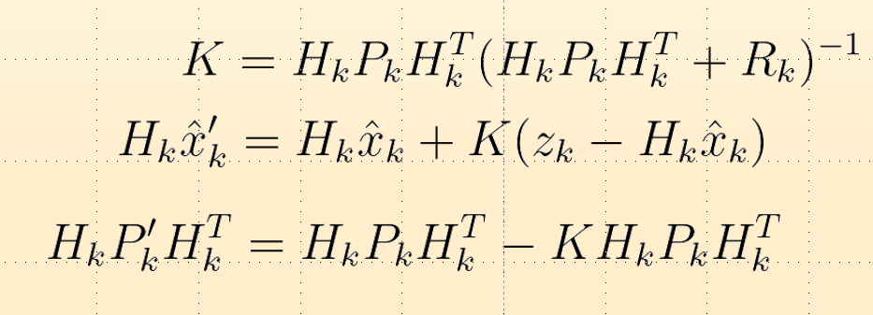


We can knock an H_k off the front of every term in
And an H_k.T off the end of all terms in the equation for P_k’.

Slide 23
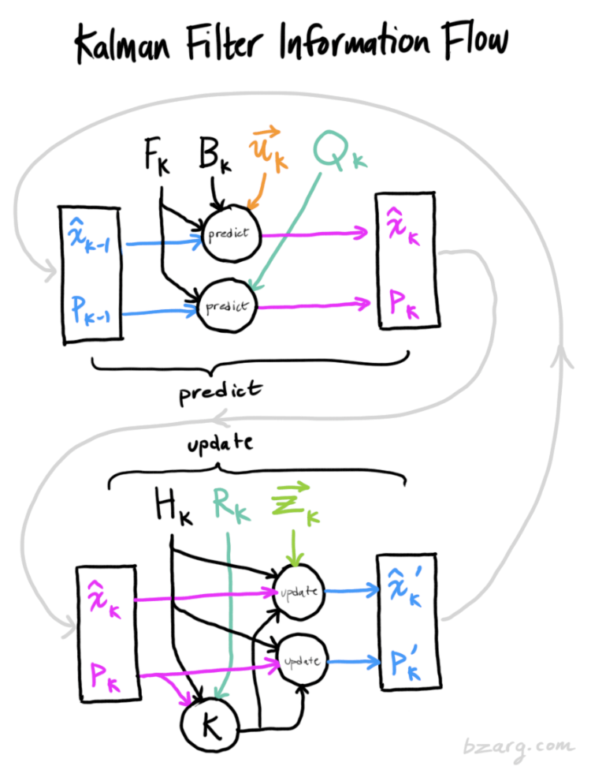


is our new best estimate, and we can go on and feed it (along with ) back into another round of prediction or update as many times as we like.

Slide 24
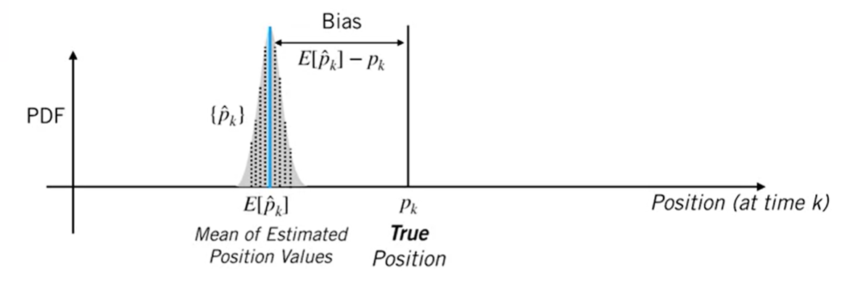


Bias
If close to 0, means our prediction is well!

Slide 25

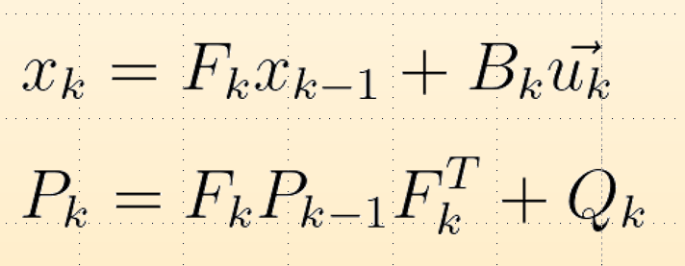
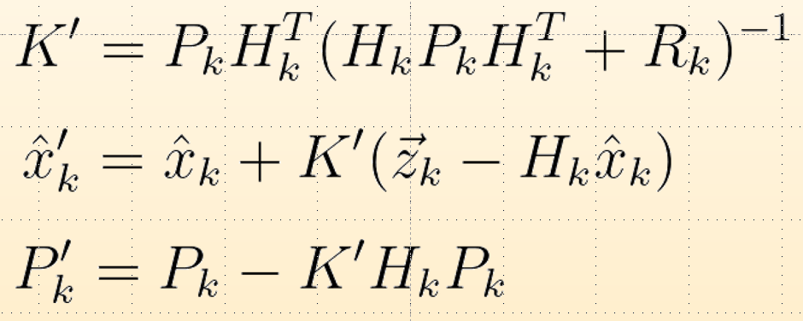


Summary
Time Update
(Predict)
Measurement Update
(Correct)
Input and

Slide 26
Extended Kalman Filter
(EKF)

Slide 27
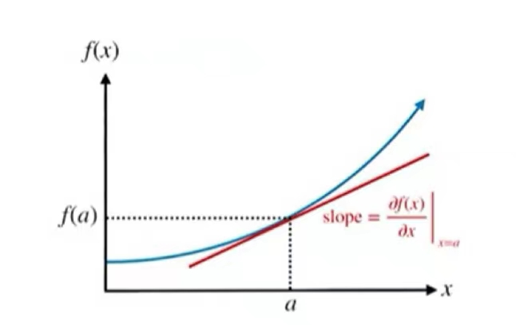
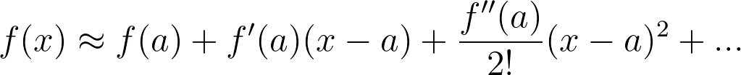
Extended Kalman Filter (EKF)
Hint: Linearization treatment of nonlinear systems
Use Taylor Expansion
Just focus on First-order terms

Slide 28




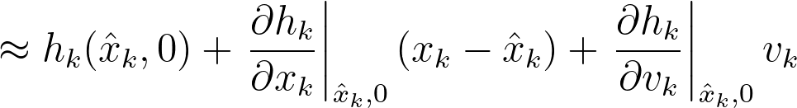


Linearized motion model
Linearized measurement model
Jacobian
Matrices

Slide 29

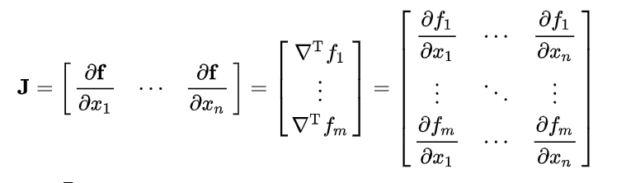
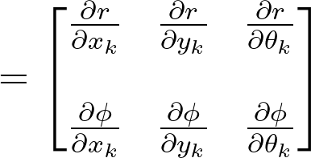

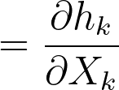


Jacobian Matrices
For example:

Slide 30
is Jacobian Matrices.
So the Kalman gain will change a little:
The rest part is the same as the Kalman Filter
We could see more detail in the Project1

Slide 31
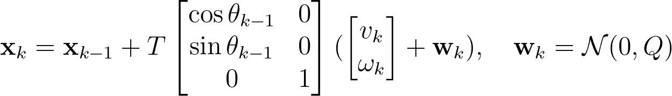

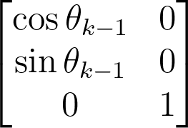

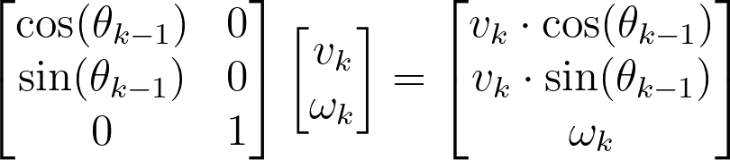
Background of Project 1
Rotation Matrix:
Time between status updates:
Velocity Vector:
Noise:

Slide 32
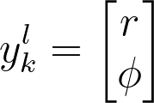
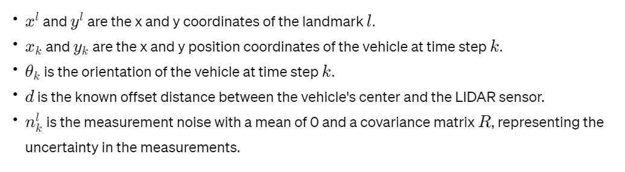
This function relates the vehicle's current state—its position and orientation—to the range and bearing measurements obtained from LIDAR for a specific landmark.
Distance
“Landmark" refers to any distinct physical object or feature in the environment that can be easily identified and has a known location that doesn't change over time. Landmarks are crucial for localization because they serve as reference points; robots or vehicles can determine their own location and orientation by measuring their distance and angle relative to these landmarks.
Azimuth

Slide 33
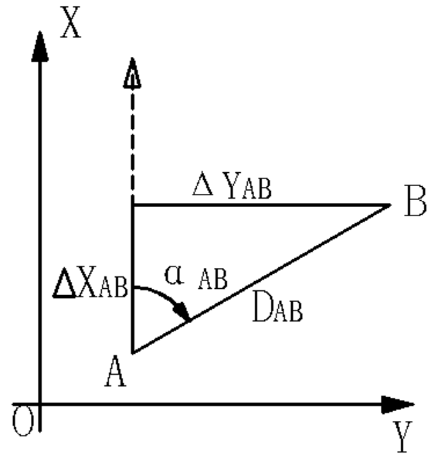
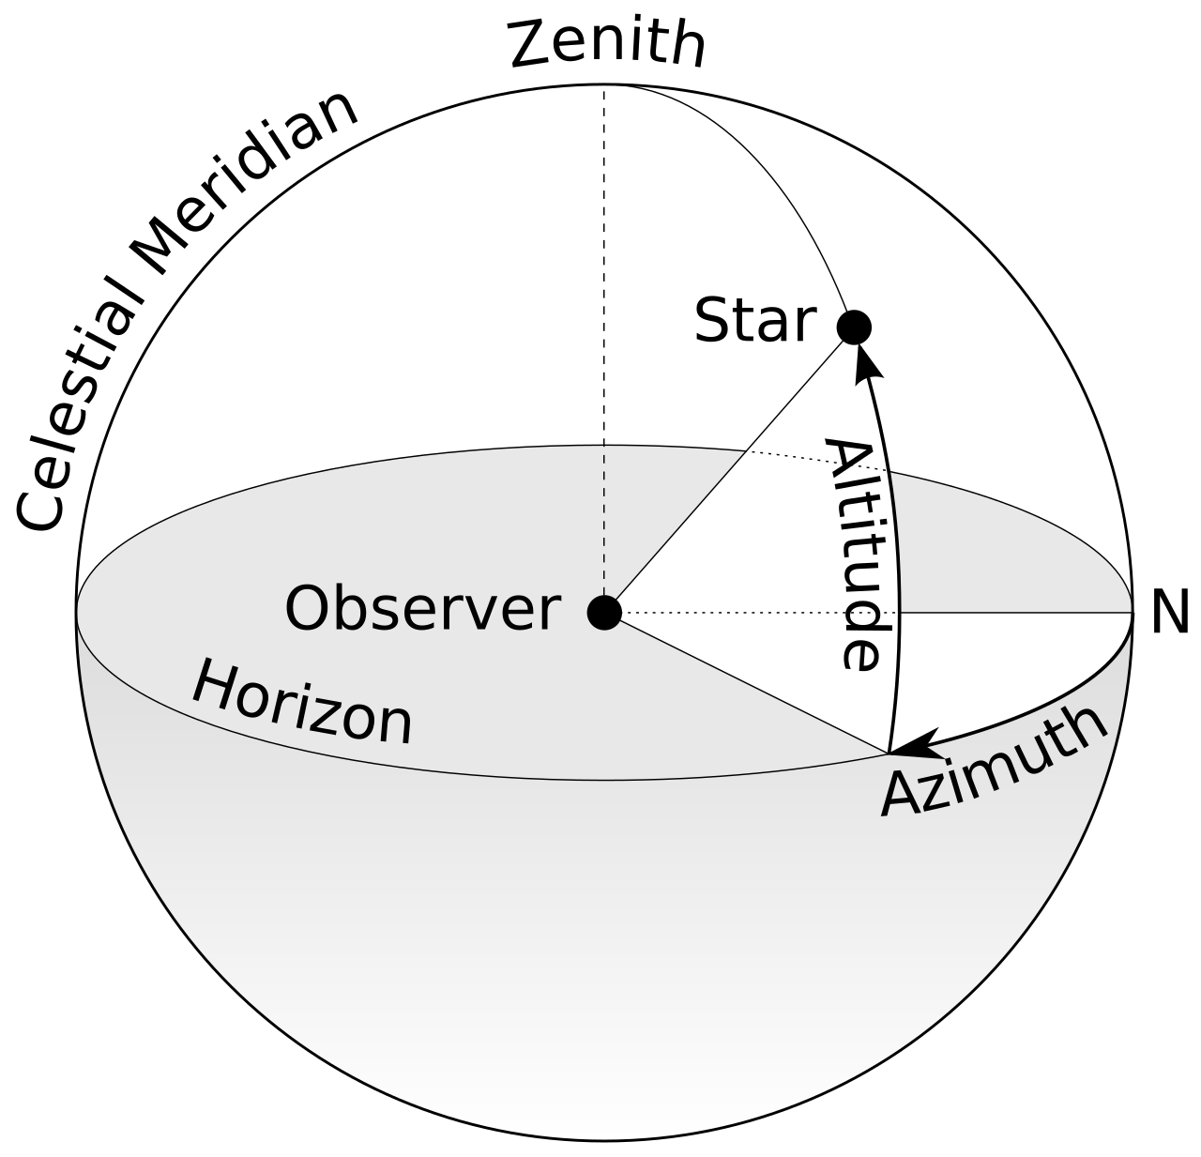
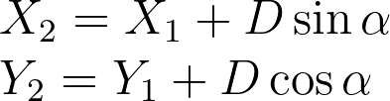
azimuth angle is the angular measurement in a spherical coordinate system that represents the horizontal angle from a cardinal direction, most commonly north.
We know two points, we can get azimuth angle
We know one azimuth angle, we can get another point

Slide 34

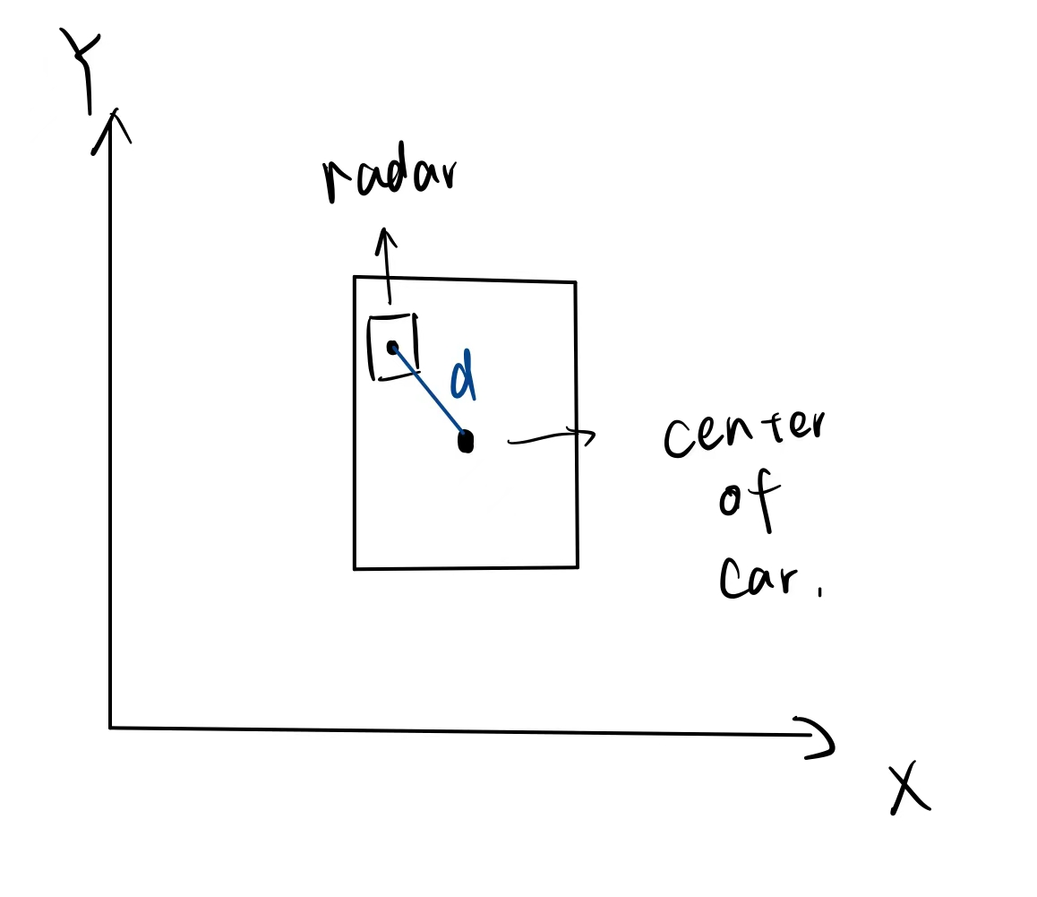
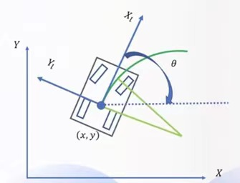
When the lidar is not at the geometric center of the vehicle, you must correct the lidar readings to ensure that they are accurate relative to the geometric center of the vehicle
When you use the atan2 function, what you get is the angle of the vector pointing from the global coordinate system to the landmark. To convert this angle to an angle relative to the vehicle's current heading, you need to subtract the vehicle's heading angle θk from the result of atan2

Slide 35



Suppose there is no noise
Mk is an Identity Matrix. It is an Additive and independent Noise

Slide 36






Slide 37
Reference
Babb, T. (n.d.). How a Kalman filter works, in pictures. Bzarg. https://www.bzarg.com/p/how-a-kalman-filter-works-in-pictures/
“State Estimation and Localization for Self-Driving Cars” launched by the University of Toronto on Coursera. https://www.coursera.org/learn/state-estimation-localization-self-driving-cars/home/week/2
Understanding Kalman filters, part 3: Optimal State Estimator. MATLAB. (n.d.). https://ww2.mathworks.cn/videos/understanding-kalman-filters-part-3-optimal-state-estimator--1490710645421.html
STC Lecture series an introduction to the Kalman filter. (n.d.). https://www.cs.unc.edu/~welch/media/pdf/kalmanIntroSlides.pdf

